Slide 1
Eclipse Debugger
Advanced debugging techniques in eclipse

Slide 2
What is debugging?
Debugging allows you to run a program interactively while watching the source code and the variables during the execution.
By breakpoints in the source code you specify where the execution of the program should stop. To stop the execution only if a field is read or modified, you can specify watchpoints .
Breakpoints and watchpoints can be summarized as stop points.
Once the program is stopped you can investigate variables, change their content, etc.

Slide 3
Debugging support in Eclipse
Eclipse allows you to start a Java program in Debug mode.
Eclipse has a special Debug perspective which gives you a preconfigured set of views. In this perspective you control the execution process of your program and can investigate the state of the variables.

Slide 4
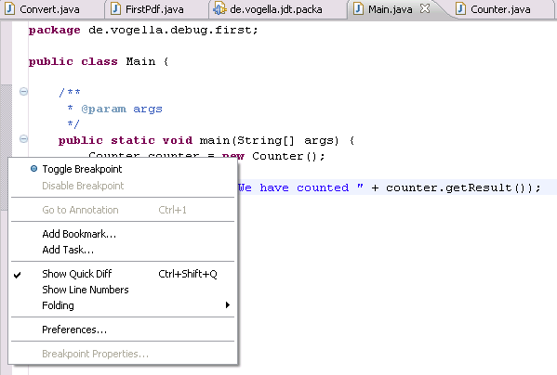
Setting BreakPoints
To set breakpoints in your source code right-click in the small left margin in your source code editor and select Toggle Breakpoint. Alternatively you can double-click on this position.

Slide 5
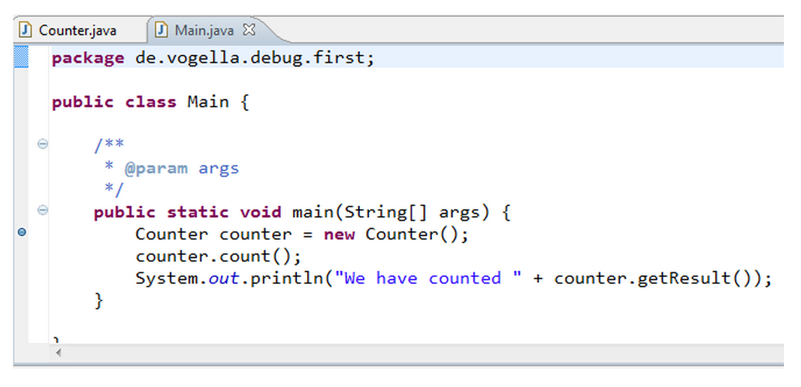
Setting BreakPoints
Breakpoint

Slide 6
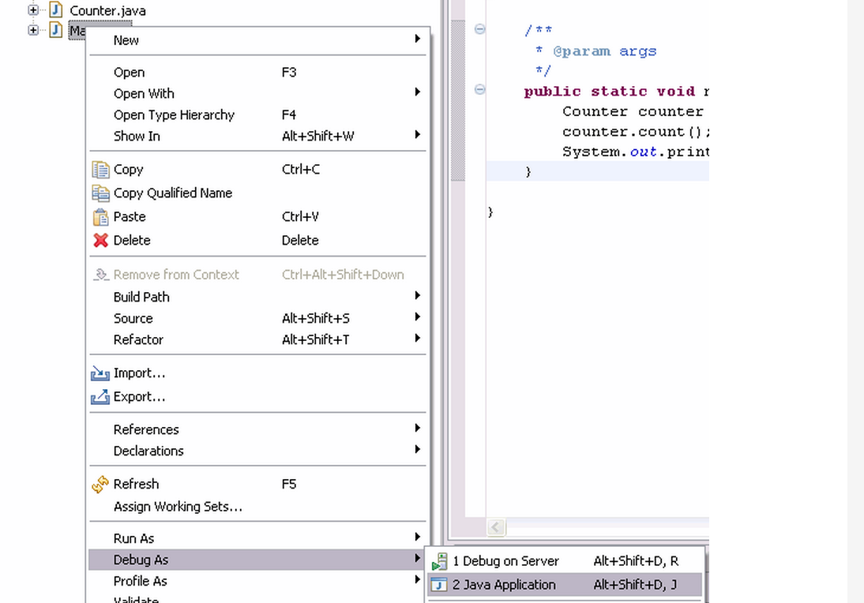

Starting the debugger
To debug your application, select a Java file which can be executed, right-click on it and select Debug As → Java Application.
After you have started the application once via the context menu, you can use the created launch configuration again via the Debug button in the Eclipse toolbar.
If you have not defined any breakpoints, this will run your program as normal. To debug the program you need to define breakpoints.

Slide 7
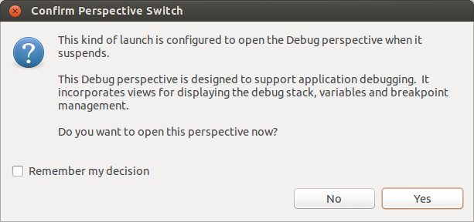
Debug Perspective
If you start the debugger, Eclipse asks you if you want to switch to the Debug perspective once a stop point is reached. Answer Yes in the corresponding dialog.

Slide 8
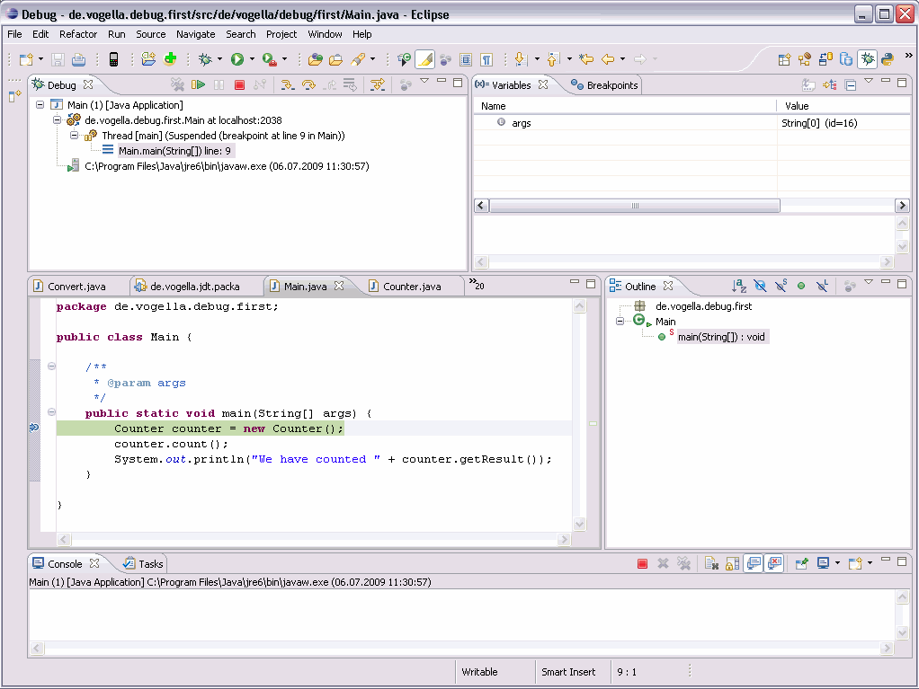
Debug Perspective
Afterwards Eclipse opens this perspective, which looks similar to the following screenshot.

Slide 9
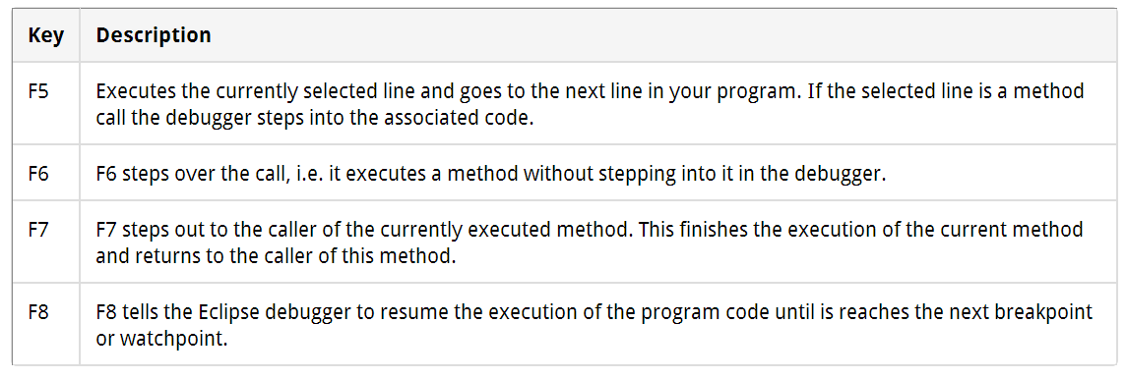
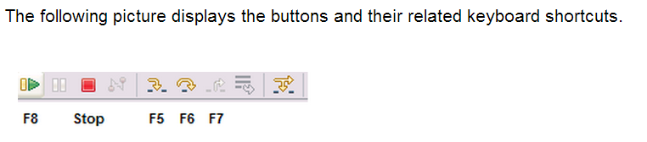
Controlling the program execution

Slide 10
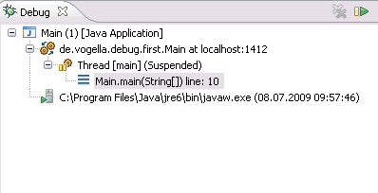
The Call Stack
The call stack shows the parts of the program which are currently executed and how they relate to each other. The current stack is displayed in the Debug view .

Slide 11
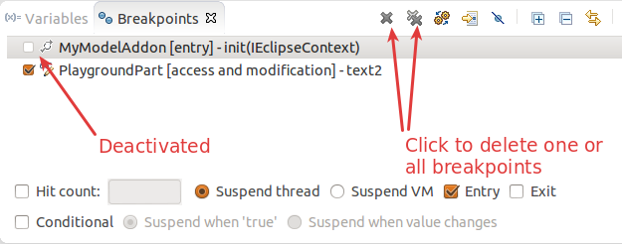
Breakpoints view and deactivating breakpoints
The Breakpoints view allows you to delete and deactivate stop points, i.e. breakpoints and watchpoints and to modify their properties.
To deactivate a breakpoint, remove the corresponding checkbox in the Breakpoints view . To delete it you can use the corresponding buttons in the view toolbar. These options are depicted in the following screenshot.

Slide 12
Breakpoints view and deactivating breakpoints
If you want to deactivate all your breakpoints you can press the Skip all breakpoints button. If you press it again, your breakpoints are reactivated. This button is highlighted in the following screenshot.

Slide 13
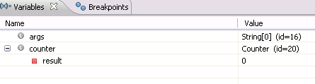
Evaluating variables in the debugger
The Variables view displays fields and local variables from the current executing stack. Please note you need to run the debugger to see the variables in this view .

